Slide 1
FIT3143
LECTURE WEEK 3
INTER-PROCESS COMMUNICATIONS
&
REMOTE PROCEDURE CALL

Slide 2
Overview
Inter process communication (IPC)
Synchronous and asynchronous communication
Remote procedure call
Learning outcome(s) related to this topic
Compare and contrast different communication and concurrency schemes (LO2)

Slide 3
Inter-process Communication (IPC)
IPC basically requires information sharing among two or more processes. Two basic methods-
Original sharing (Shared data approach)
Copy Sharing (Message passing approach)
Shared
Common
Memory Area
P2
P1
P2
P1
Shared data approach
Message passing approach

Slide 4
Message Passing System
A message-passing system is a sub-system of a distributed system that provides a set of message-based IPC protocols and does so by shielding the details of complex network protocols and multiple heterogeneous platforms from programmers.
It enables processes to communicate by exchanging messages
Allows programs to be written by using simple communication primitives, such as send and receive.
Serves as a suitable infrastructure for building other higher level IPC systems, such as RPC (Remote Procedure Call) and DSM (Distributed Shared Memory).

Slide 5
Desirable features of a good message passing system
Simplicity
Uniform semantics
Same primitives for local and remote communication
Efficiency
Reduce the number of message as far as possible
Some optimization normally adopted for efficiency include-
Avoiding the cost of establishing and terminating connections between the same pair of processes for each and every message exchange between them
Minimizing cost of maintaining connections
Piggybacking of acknowledgment of previous message with the next message.

Slide 6
Desirable features of a good message passing system
Reliability
Lost and duplicate message handling
Correctness
Atomicity
Ordered delivery
Survivability
Flexibility
Can drop one or more correctness properties

Slide 7
Desirable features of a good message passing system
Security
Authentication of sender and receiver
Encryption of messages
Portability
Message passing system should itself be portable
The application written by using primitives of the IPC protocol should be portable.

Slide 8
Issues in IPC by message passing
A typical message structure
Header
Addresses
Sender address
Receiver address
Sequence number
Structural information
Type
Number of bytes
Message

Slide 9
Issues need to be considered for designing an IPC protocol
Some of the main issues will be,
Identity related
Who is the sender?
Who is the receiver?
Network Topology related
1 receiver or many?
Flow control related
Guaranteed by the receiver?
Sender should wait for reply?
Error control and channel management
Node crash……what to do?
Receiver not ready….what to do?
Several outstanding messages for the receiver

Slide 10
Synchronization in IPC
Send primitive
Blocking
Non blocking
Receive primitive
Blocking
Non Blocking
Polling
interrupt
IPC Synchronization
Semantics
Blocking
Non Blocking

Slide 11
Synchronous & Asynchronous Communication
When both the send and receive primitives of a communication between two processes use blocking semantics, the communication is said to be Synchronous; otherwise it is asynchronous.
Sender
Receiver
Receive (message)
Execution suspended
Message
Execution resumed
Execution resumed
Acknowledgment
Synchronous mode with blocking send and receive primitives

Slide 12
Synchronous VS Asynchronous Communication
Synchronous
Simple and easy to implement
Contributes to reliability
No backward error recovery needed
Asynchronous
High concurrency
More flexible than synchronous
Lower deadlock risk than in synchronous communication ( but beware)

Slide 13
Buffering
Synchronous systems
Null buffer
Single message buffer
Asynchronous systems
Unbounded capacity buffer
Finite message (multiple message buffer)

Slide 14
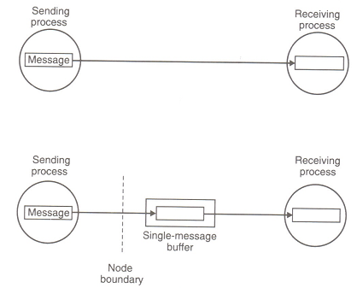
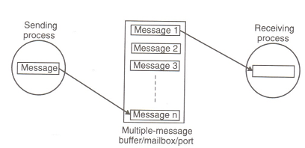
Buffering
Synchronous System
Asynchronous System

Slide 15
Multi-datagram Messages
Almost all networks have an upper bound on the size of data that can be transmitted at a time. This is known as MTU (maximum transfer unit).
Thus a message whose size is greater than MTU has to be fragmented- each fragment is sent in a packet. These packets are known as datagram.
Thus messages may be single-datagram messages or multi-datagram messages
Assembling and dissembling is the responsibility of message passing system.

Slide 16
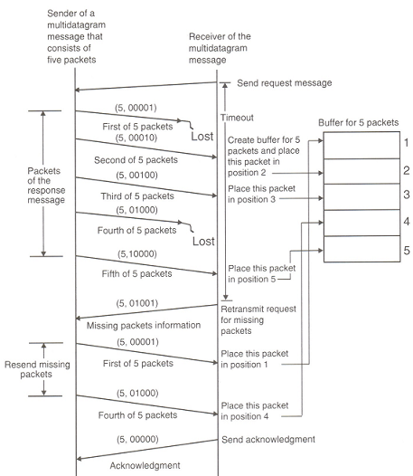
Using Bitmap for multidatagrams
Notes:
Only lost packets are re-sent

Slide 17
Encoding Decoding
Encoding/Decoding is needed if
Sender and receiver have different architecture
Even for Homogeneous Encoding/Decoding is needed for
Using an absolute pointer
To know which object is stored in where and how much storage it requires
Notes:
Dynamic memory maps differ

Slide 18
Process Addressing
Explicit Addressing
Send(process_ID, message)
Receive(process_ID, message)
Implicit Addressing
Send_any(service_ID, message)
Receive_any(process_ID, message)

Slide 19
Failure Handling
Failure classification
Loss of request message
Loss of response message
Unsuccessful execution of the request
sender
receiver
sender
receiver
sender
receiver
Request
Request
Request
crash
Lost
response
Lost

Slide 20
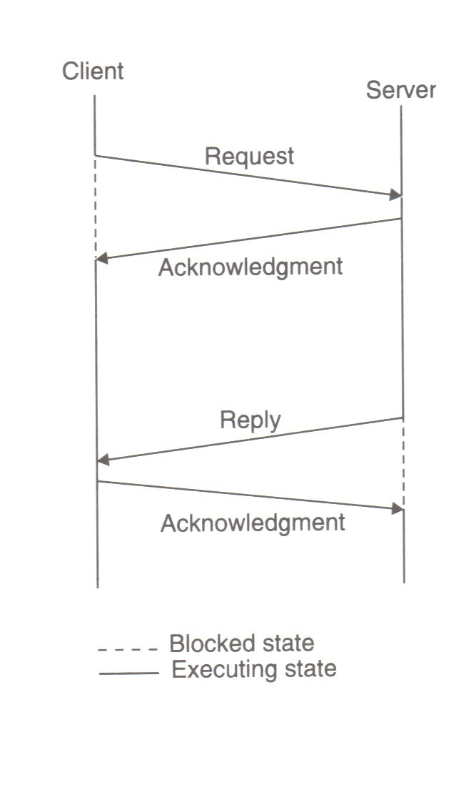
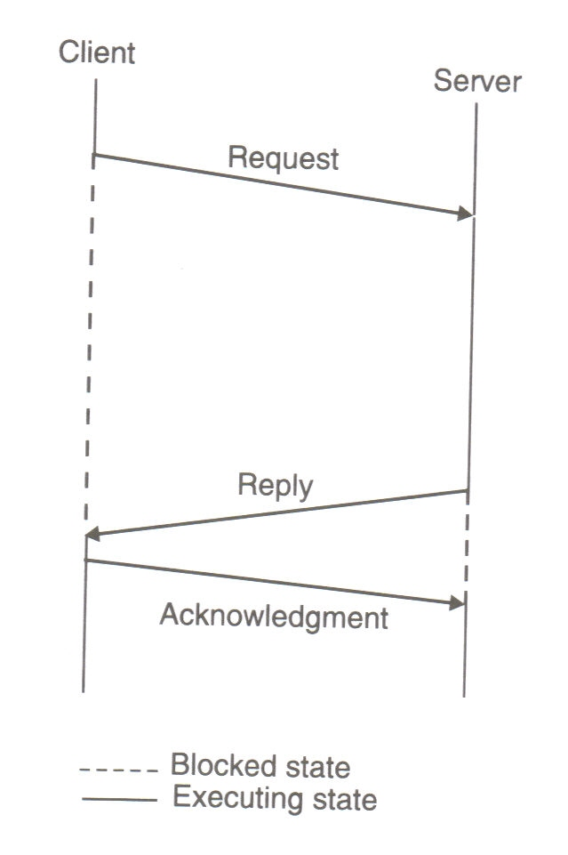
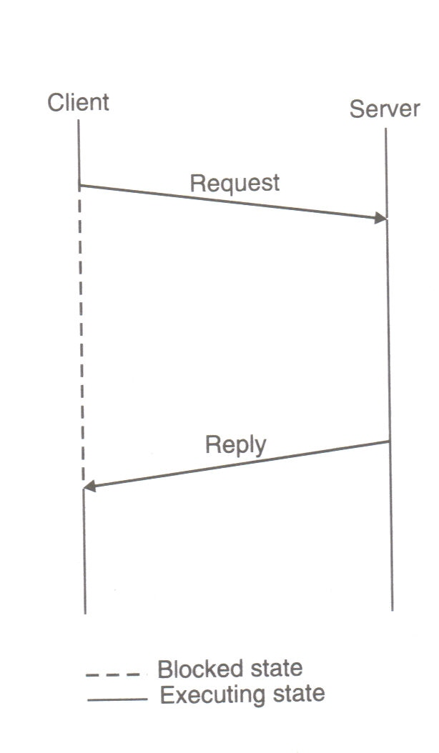
Reliable IPC protocol
4-message protocol
3-message protocol
2-message protocol

Slide 21
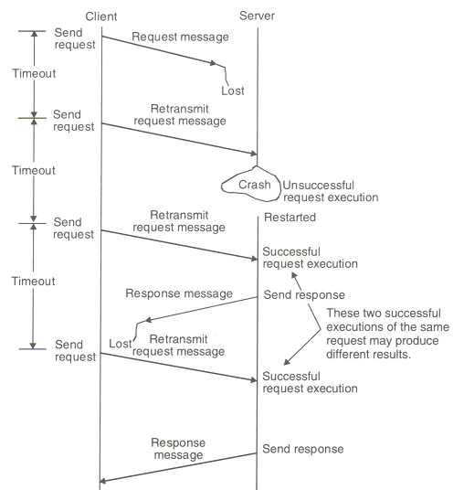
An Example of Fault Tolerant System
Notes:
Problems
Violation of atomic operations
Adds to, if network is the problem

Slide 22
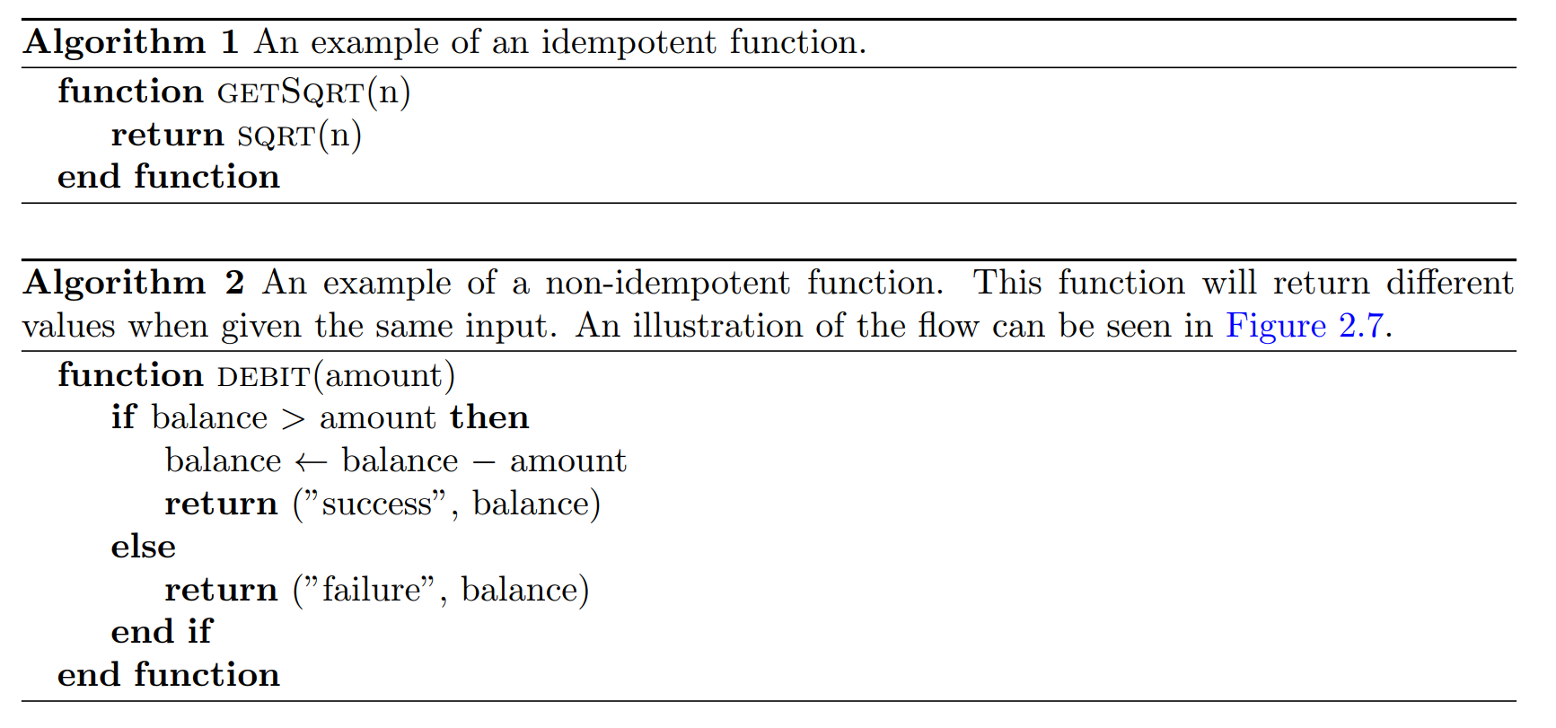
Idempotency
An idempotent function will return the same result given the same input, even when executed multiple times. For example, an idempotent function is illustrated in Algorithm 1; a nonidempotent function is illustrated in Algorithm 2.
*
*Note: Figure 2.7 refers to the following slide

Slide 23
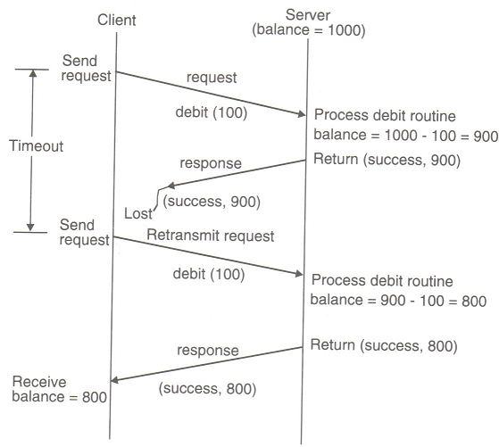
A Non-Idempotent Routine

Slide 24
Implementation of Idempotency
How to implement Idempotency?
Adding sequence number with the request message
Introduction of ‘Reply cache’

Slide 25
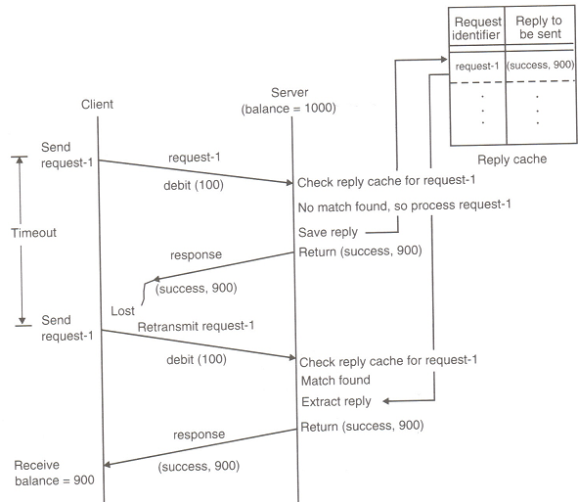
Implementation of Idempotency

Slide 26
Group Communication
Group communication may be
One to many
Many to one
Many to many
One to many
Group management
Group addressing
Buffered and unbuffered multicast
Send-to-all and Bulletin-Board semantics
Flexible reliability in multicast communication
Atomic multicast

Slide 27
Many to Many communication
The issues related to one-to-many and many-to-one communications also applies here
In addition, ordered message delivery is an important issue. This is trivial in one-to-many or many-to-one communications.
For example, two server processes are maintaining a single salary database. Two client processes send updates for a salary record. What happen if they reach in different order? (will sequencing of messages help in this case?)

Slide 28
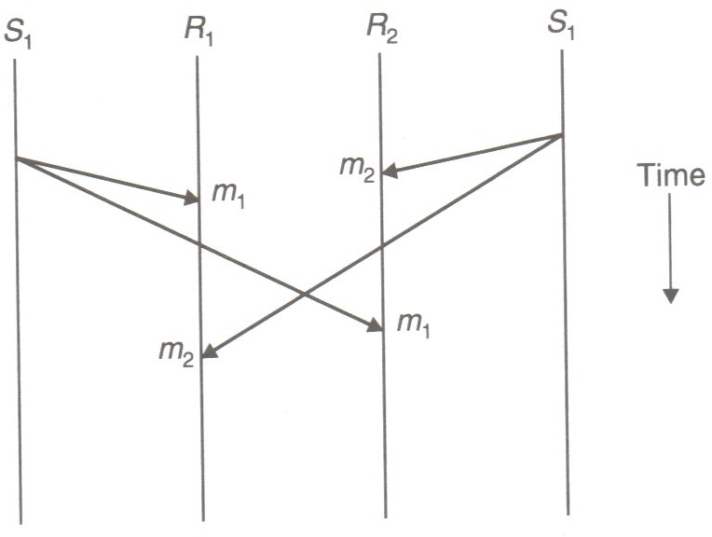
Semantics for ordered delivery in many-to-many comm.
No-ordering
2
No ordering constraint

Slide 29
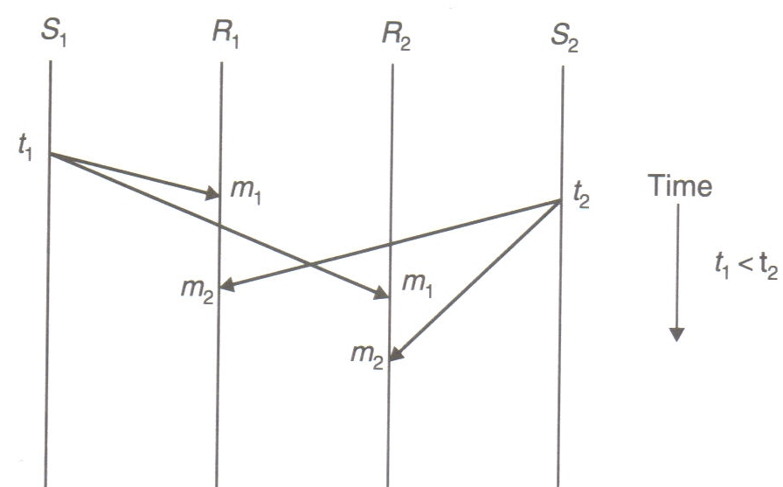
Semantics for ordered delivery in many-to-many comm.
Absolute ordering
All messages are delivered to all receiver processes in the exact order in which they were sent.
Using global timestamp as message identifiers with sliding window protocol
Absolute ordering semantic

Slide 30
Semantics for ordered delivery in many-to-many comm.
Consistent ordering
All messages are delivered to all receivers in the same order. However, this order may be different from the order in which messages were sent.
Implementation
Make the communication appear as a combination of many-to-one and one-to-many communication [Chang and Maxemchuk]
Kernels of sending machines send messages to a single receiver (known as sequencer) that assigns a sequence number to each message and then multicast it.
Subject to single point of failure and hence has poor reliability.
A distributed algorithm - ABCAST in ISIS system [Birman and Renesse] (self study)

Slide 31
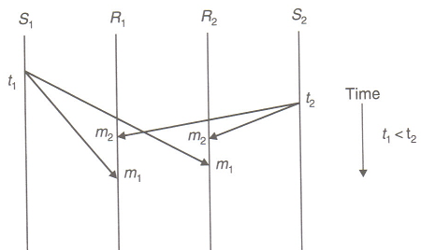
Semantics for ordered delivery in many-to-many comm.
Consistent ordering semantic
Notes:
Assume order being m2 then m1.It is preserved even though t2 > t1.

Slide 32
Semantics for ordered delivery in many-to-many comm.
Causal ordering
If the event of sending one message is causally related to the event of sending another message, the two messages are delivered to all receivers in correct order.
Two message sending events are said to be causally related if they are corelated by the happened-before relation.
[ The expression a→b is read “a happens before b" and means that all processes agree that first event a occurs, then afterward, event b occurs. The happens-before relation can be observed directly in two situations:
1. If a and b are events in the same process, and a occurs before b, then a→b is true.
2. If a is the event of a message being sent by one process, and b is the event of the message being received by another process, then a→b is also true.
Happens-before is a transitive relation, so if a→b and b→c, then a→c. ]

Slide 33
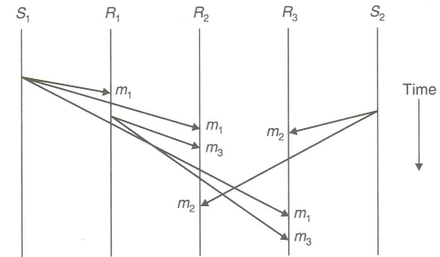
Semantics for ordered delivery in many-to-many comm.
One example of implementing Causal consistency is CBCAST in ISIS system [Birman et al].
3rd round m2 is held back
Causal ordering semantic
Notes:
Messages placed in hold-back queue until it can be correctly placed

Slide 34
Remote Procedure Call (RPC)
The IPC part of a distributed application can be adequately and efficiently handled by using an IPC protocol based on message passing system.
However, an independently developed IPC protocol is tailored specifically to one application and does not provide a foundation on which to build a variety of distributed applications.
Therefore, a need was felt for a general IPC protocol that can be used for designing several distributed applications.
The RPC facility emerged out of this need.

Slide 35
Remote Procedure Call
While the RPC is not the universal panacea for all types of distributed applications but for a fairly large number of distributed applications.
The RPC has become a widely accepted IPC mechanism in DS. Its features –
Simple call syntax.
Familiar semantics.
Specification of a well defined interface.
Ease of use.
Generality. “In single-machine computations procedure calls are often the most important mechanism for communication between the parts of the algorithm” [Birrell and Nelson].
Its efficiency

Slide 36
RPC model
RPC model is similar to “Procedure call” model.
Procedure call is same as function call or subroutine call
Local Procedure Call - The caller and the callee are within a single process on a given host.
Remote Procedure Call (RPC) - A process on the local system invokes a procedure on a remote system. The reason we call this a “procedure call” is because the intent is to make it appear to the programmer that a local procedure call is taking place.

Slide 37
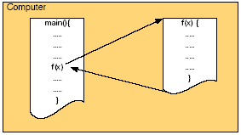
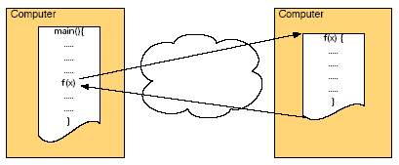
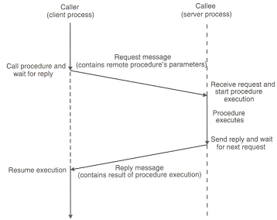
Local and Remote Procedure Call
Local Procedure Call
Remote Procedure Call
A Typical Model of RPC

Slide 38
Implementing RPC mechanism
To achieve the goal of semantic transparency, the implementation of an RPC mechanism is based on the concept of stubs
Stubs provide a perfectly normal(local) procedure call abstraction
To hide the distance and functional details of underlying network, an RPC communication package (known as RPCRuntime) is used.
Thus RPC implementation involves five elements-
The client
The client stub
The RPCRuntime
The server stub
The server

Slide 39
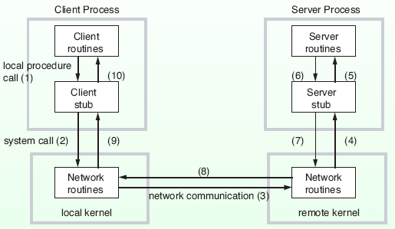
RPC in Detail

Slide 40
Stubs
Client and server stubs are generated from interface definition of server routines by development tools.
Interface definition is similar to class definition in C++ and Java.

Slide 41
Parameter Passing Mechanisms
When a procedure is called, parameters are passed to the procedure as the arguments. There are three methods to pass the parameters.
◦call-by-value
◦call-by-reference
◦call-by-copy/restore

Slide 42
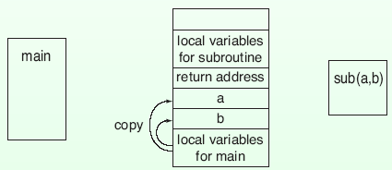
Call by value
The values of the arguments are copied to the stack and passed to the procedure.
The called procedure may modify these, but the modifications do not affect the original value at the calling side.

Slide 43
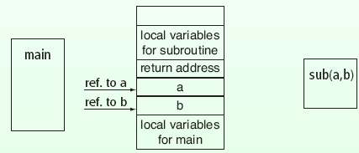
Call-by-Reference
The memory addresses of the variables corresponding to the arguments are put into the stack and passed to the procedure.
Since these are memory addresses, the original values at the calling side are changed if modified by the called procedure.

Slide 44
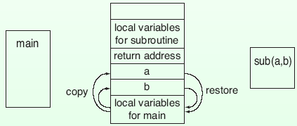
Call-by-Copy/Restore
The values of the arguments are copied to the stack and passed to the procedure.
When the processing of the procedure completes, the values are copied back to the original values at the calling side.
If parameter values are changed in the subprogram, the values in the calling program are also affected.

Slide 45
Parameter Passing in RPC
Which parameter passing mechanisms are possible?
◦It is possible to implement all of the three mechanisms if you wish. Usually call-by-value and call-by-copy/restore are used.
◦Call-by-reference is difficult to implement. All data which may be referenced must be copied to the remote host and the reference to the copied data is used.
Do we need to convert the values of the arguments into a standard format to transmit over the network?

Slide 46
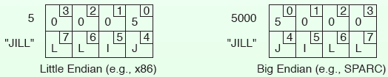
Parameter Passing in RPC
Reasons to convert the values of the arguments into a standard format to transmit over the network
◦Different machines use different character codes. E.g., IBM main frames use EBCDIC, while PCs use ASCII.
◦Representation of numbers may differ from machine to machine.
◦Big endian and little endian
Notes:
Note: Little Endian row label of 5 is compactly representing 0005 in this figure.

Slide 47
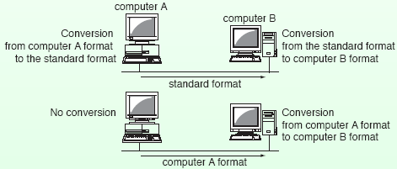
Parameter Passing in RPC
If a standard format is not used, two message conversions are necessary.
◦If format information is attached to the message, only one conversion at the receiver will suffice.
◦However, the receiver must be able to handle many different formats.

Slide 48
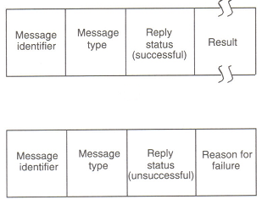
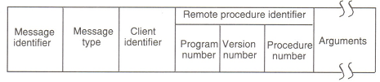
RPC Messages
Generally two types of messages
Call messages
Reply messages
A typical RPC Call message format
A typical RPC Reply message format
(successful and unsuccessful)

Slide 49
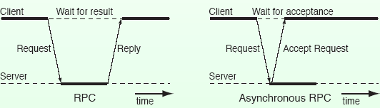
Variations of RPC
Asynchronous RPC
RPC (When a client requests a remote procedure, the client wait until a reply comes back in RPC.
If no result is to be returned, unnecessary wait time overhead.
In asynchronous RPC, the server immediately sends accept message when it receives a request.

Slide 50
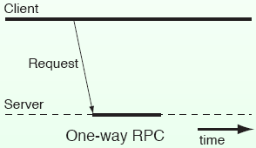
Call-Back RPC
One-way RPC
In one-way RPC, the client immediately continues after sending the request to the server.

Slide 51
Some special types of RPC
Callback RPC
Broadcast RPC
Batch-mode RPC
Lightweight RPC

Slide 52
Optimizations for better Performance
In Six Different Ways
Concurrent access to multiple servers
Serving multiple requests simultaneously
Reducing per-call workload of servers
Reply caching of idempotent remote procedures
Proper selection of timeout values
Proper design of RPC protocol specification

Slide 53
Concurrent Access to Multiple Server
One of the following three may be adopted:
Threads
Use of Threads in the implementation of a client process where each thread can independently make remote procedure calls to different servers.
Addressing in underlying protocol should be rich enough to provide correct routing of responses.
Early reply approach [Wilbur and Bacarisse]
A call is split into two separate RPC calls- one passing parameters and other requesting the result
Server must hold the result causing congestion or unnecessary overhead.
Call buffering approach [Gimson]
Clients and servers do not interact directly but via a call buffer server
A variant of this approach was implemented in MIT (Mercury Communication System)

Slide 54
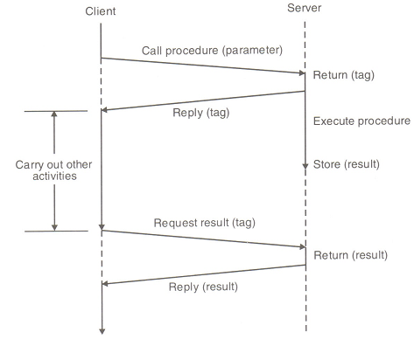
Early Reply Approach

Slide 55
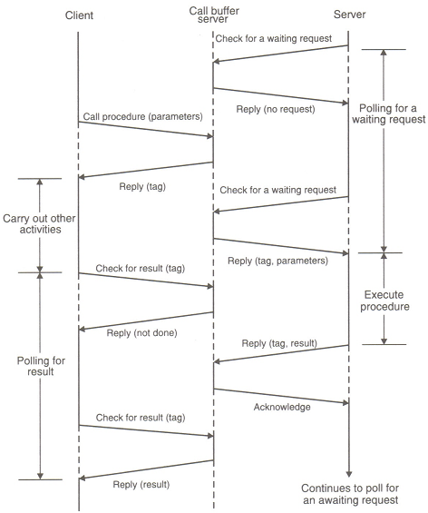
Call Buffering Approach

Slide 56
Serving Multiple Requests Simultaneously
Following types of delays are common-
A server, during the course of a call execution, may wait for a shared resource
A server calls a remote function that involves computation or transmission delays
So the server may accept and process other requests while waiting to complete a request.
Multiple-threaded server may be a solution.

Slide 57
Summation
What is the purpose of IPC?
information sharing among two or more processes
Differences between Synchronous and Asynchronous Communications?
When both the send and receive primitives of a communication between two processes use blocking semantics, the communication is said to be Synchronous; otherwise it is asynchronous
List the Types of Failure in IPC
Loss of request message, Loss of response message, Unsuccessful execution of the request
How to implement Idempotency?
Adding sequence number with the request message and Introduction of ‘Reply cache’
Three main types of Group Communications?
One to many, Many to one, Many to many
One of the greatest challenges in Many to Many?
Ordered Delivery
Name an all propose IPC protocol?
Remote Procedure Call (RPC)
Name a few ways to optimise RPC?
Concurrent Access to Multiple Servers, Serving Muliple Requests Concurrently, Reducing Call Workload per Server
Three different techniques for implementing Concurrent Access to Multiple Servers?
Threads, Early Reply, Call Buffering

Slide 58
References
Birman, K. P. and Renesse, R. V. Reliable Distributed Computing with the ISIS Toolkit. IEEE Computer Society Press, 1994.
Birrell, A. D. and Nelson, B. J. Implementing remote procedure calls. ACM Trans. Comput. Syst. 2(1), 39-59, 1984.
Wilbur, S. and Bacarisse, B. Building distributed systems with remote call, Software Engineering Journal, 2(5), 148-159, 1987.
R. Gimson. Call buffering service. Technical Report 19, Programming Research Group, Oxford University, Oxford University, Oxford, England, 1985.

